Slide 1

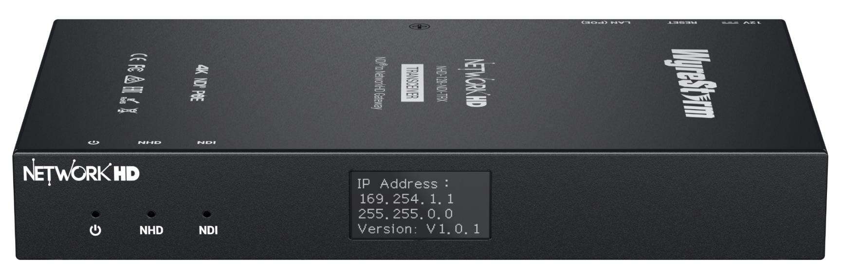
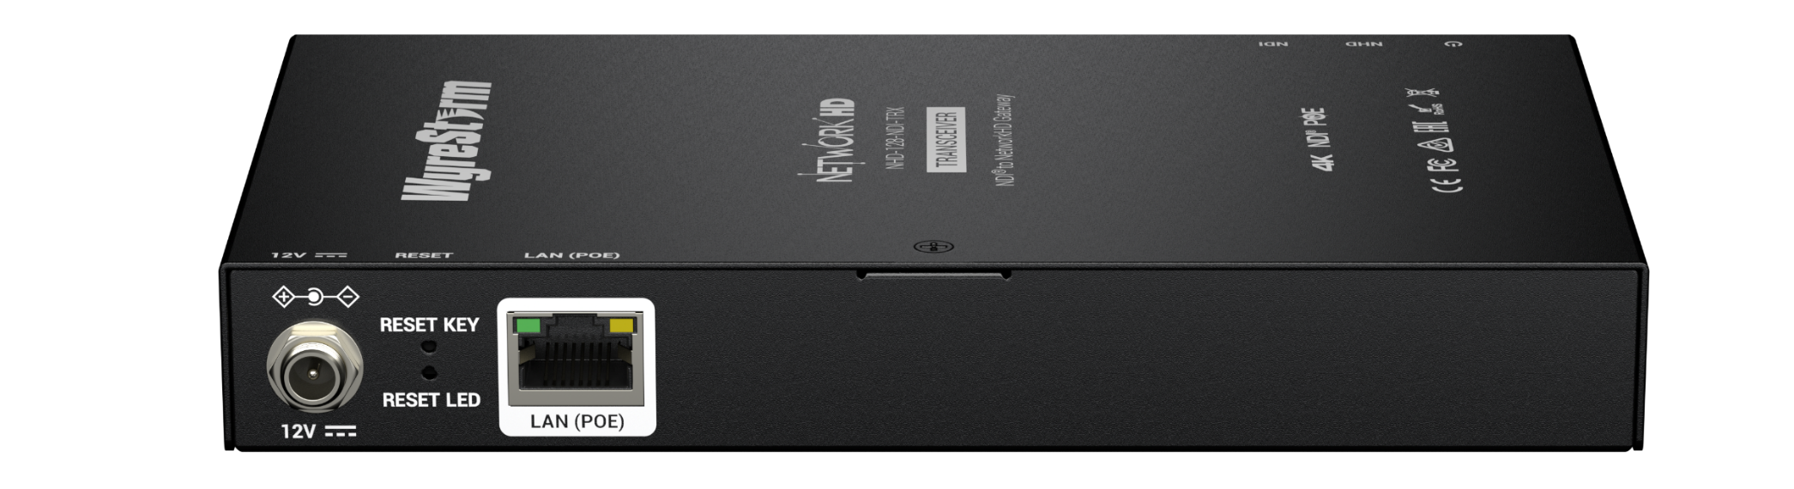

NHD-128-NDI-TRX
Product Guide
NDI-NetworkHD Bi-directional Gateway
Award-Winning Audio-Visual Solutions Manufacturer

Slide 2

Contents
Product Overview & Key Features
Why Choose Us?
Interface & Specifications
Typical Connection & Applications
Competitor Analysis
Quick Installation Guide & Web UI Introduction
Q & A Session
Powerful · Reliable · Simple

Slide 3


Product Overview
NDI-NetworkHD Bi-directional Gateway
The NHD-128-NDI-TRX is a powerful and versatile gateway designed to enable bidirectional conversion between NDI and NetworkHD streams. When paired with NetworkHD 100 Series products, it provides smooth and efficient integration within IP-based video workflows.
With support for up to 8 channels of NDI-to-NetworkHD conversion and 1 channel of NetworkHD-to-NDI output, the NHD-128-NDI-TRX offers a scalable and flexible solution for managing high-density video sources. It is especially well-suited for multi-camera environments where reliable stream conversion is essential.
Ideal for applications such as digital courtrooms, lecture halls, and other AV-over-IP scenarios, this gateway ensures dependable interoperability between systems while streamlining deployment and reducing infrastructure complexity.
Powerful · Reliable · Simple

Slide 4







Main Features
Reliable NDI Stream to NetworkHD Stream Conversion
Convert NDI streams to NetworkHD streams, enabling seamless routing to decoders. Ideal for digital courtrooms, lecture halls, and other multi-camera AV-over-IP systems.
Intuitive Web UI for Easy Control
Equipped with a powerful and user-friendly Web UI for configuration, monitoring, and firmware updates. Simplifies setup for installers and boosts productivity in dynamic environments.
Seamless NetworkHD Stream to NDI Stream Conversion
Effortlessly convert sources from NetworkHD into NDI streams—ideal for AV-over-IP environments. Enables cost-effective migration to IP workflows without the need to replace legacy devices.
Comprehensive API and Protocol Support
Offers versatile API interfaces supporting multiple control protocols (Telnet, SSH, etc.), ideal for system integrators building customized control platforms for enterprise or broadcast needs.
Crystal-Clear 4K@30Hz Video Quality
Supports 4K@30Hz resolution for both input and output, ensuring ultra-clear visuals for presentations, signage, and live video. Delivers exceptional image detail with stable signal transmission.
Device Information Monitoring with LCD Screen
The front-panel LCD displays IP address and firmware version, providing quick check for device basic information.
Video Preview Supported
Supports preview streaming for real-time video monitoring—perfect for validating sources during setup or managing large deployments.
Powerful · Reliable · Simple

Slide 5
Why Choose Us: 1. Bring More Possibility to AV over IP System
Breaks the barrier between NetworkHD and NDI networks, enabling seamless interoperability between two systems through conversion.
Bi-Directional Conversion
High-Quality Performance
Supports both NDI stream to NetworkHD stream and NetworkHD stream to NDI stream conversion at the same time, enabling efficient AV signal management through one device.
Deliver 4K@30Hz video and low latency transmission for professional-grade visuals and real-time interaction across networked environments.
Bring Multiview to NDI
Supports the conversion of multiview output from the NHD-150-RX into an NDI stream, allowing multiple video sources to be seamlessly integrated into any NDI-based system.
Powerful · Reliable · Simple

Slide 6
Why Choose Us: 2. Easy Deployment and Effortless Control
Enable seamless workflows with one device that converts between NDI and NetworkHD streams simultaneously — reducing hardware requirements and increasing integration flexibility.
Effortless Connectivity
Seamless Integration
Streamline installation with just a single network cable that carries power, video, and control in one connection. Reduce clutter and minimize setup time.
Seamlessly integrates into existing AV infrastructures with native support for both NDI and NetworkHD, making it an ideal choice for lecture halls, conference rooms, and digital courtrooms.
Boost Operational Efficiency
Real-Time LCD Status Monitoring
Enable fast setup and centralized control via intuitive Web UI and APIs—freeing up time for content creation, not system maintenance.
Front-panel display shows IP address and firmware version in real time, providing quick check for device information.
Powerful · Reliable · Simple

Slide 7
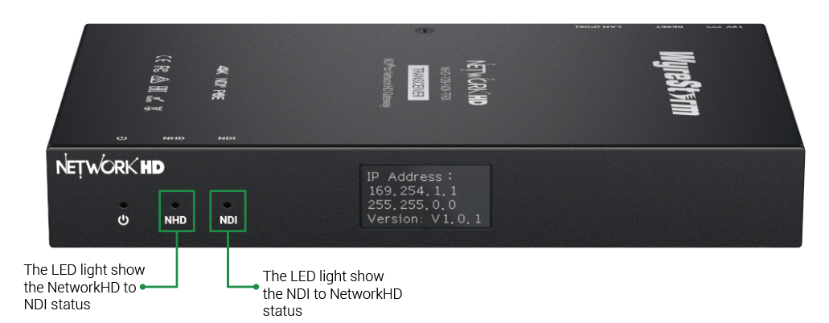
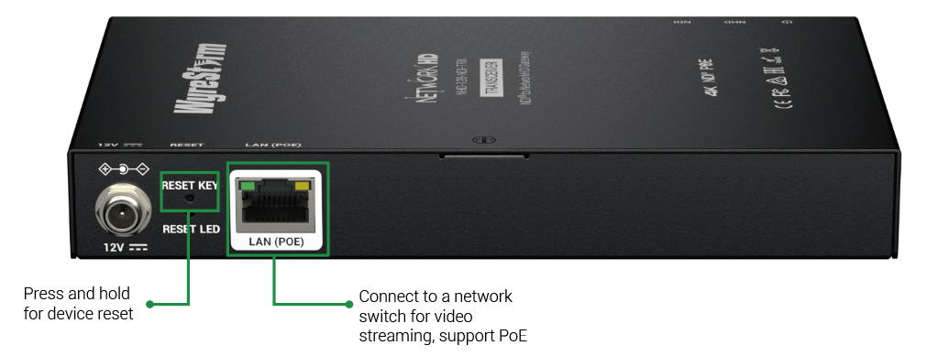
Interface of the Product
Front Panel
Featuring:
LCD Screen
The LCD screen on the front panel displays the device’s IP address and firmware version in real time.
All-in-One LAN Port
Support PoE on the single LAN port. Enable bidirectional conversion between NetworkHD and NDI streams.
Rear Panel
Powerful · Reliable · Simple

Slide 8
Specifications & Packing List
Main Specifications
Input Video | NetworkHD | Timing up to 4K@30Hz Bitrate up to 16Mbps
 | NDI | Main stream: Timing up to 4K@30Hz Bitrate up to 16Mbps Preview stream: Timing up to 480P@60Hz Bitrate up to 1Mbps
Output Video | NetworkHD | Timing up to 4K@30Hz Bitrate up to 16Mbps
 | NDI | Main stream: Timing up to 4K@30Hz Bitrate up to 20Mbps Preview stream: CIF@30 Bitrate up to 512Kbps
NDI Protocol |  | NDI HX (NDI 6)
LAN |  | 1x LAN: 8-pin RJ-45 Female | 10/100/1000Base-T | PoE 802.3af
Control Methods |  | Web UI | Telnet | Telnet TLS | SSH
What’s in the Box?
1x NHD-128-NDI-TRX
4x Wall Plastic Mounting Ears
2x Rack Mounting Ears for NHD-000-RACK4 vertical installation.
Powerful · Reliable · Simple

Slide 9
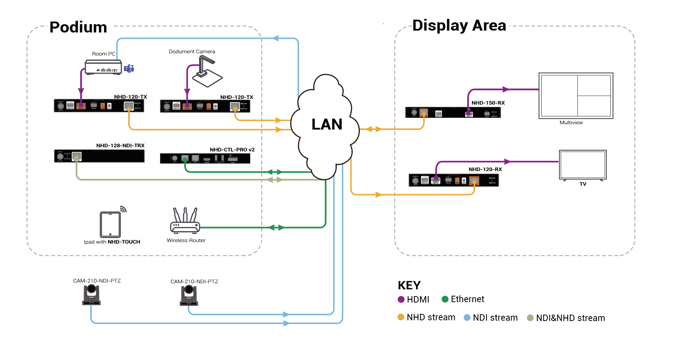
Typical Connection & Applications
The NHD-128-NDI-TRX supports bi-directional conversion between NetworkHD and NDI streams. It is ideal for digital courtrooms, lecture halls, and other environments requiring seamless integration between the two systems. Please refer to the typical connection diagram below.

Slide 10
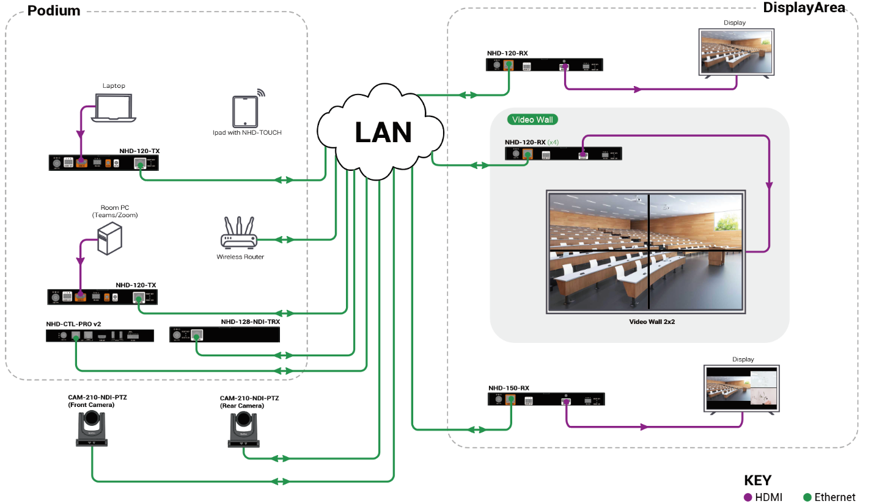
Typical Connection & Applications
Application Scenario 1: Lecture Hall
Deliver a comprehensive remote teaching solution that connects in-class and online students. Both groups can simultaneously view shared courseware and live camera feeds of instructors and classmates, creating an engaging and immersive learning experience across locations.
Key Benefits Include:
Multiview Function: Present camera feeds and course content on the same screen to provide a complete view of the lecture environment.
NDI Integration: Easily incorporate NDI cameras for fast setup and flexible streaming. NDI signals can also be converted to NetworkHD format for local display on monitors.
Remote Teaching: Stream NDI camera feeds directly into conferencing platforms like Zoom or Microsoft Teams, enabling real-time classroom access for remote students. Perfect for hybrid teaching, distance learning, and modern educational models.

Slide 11
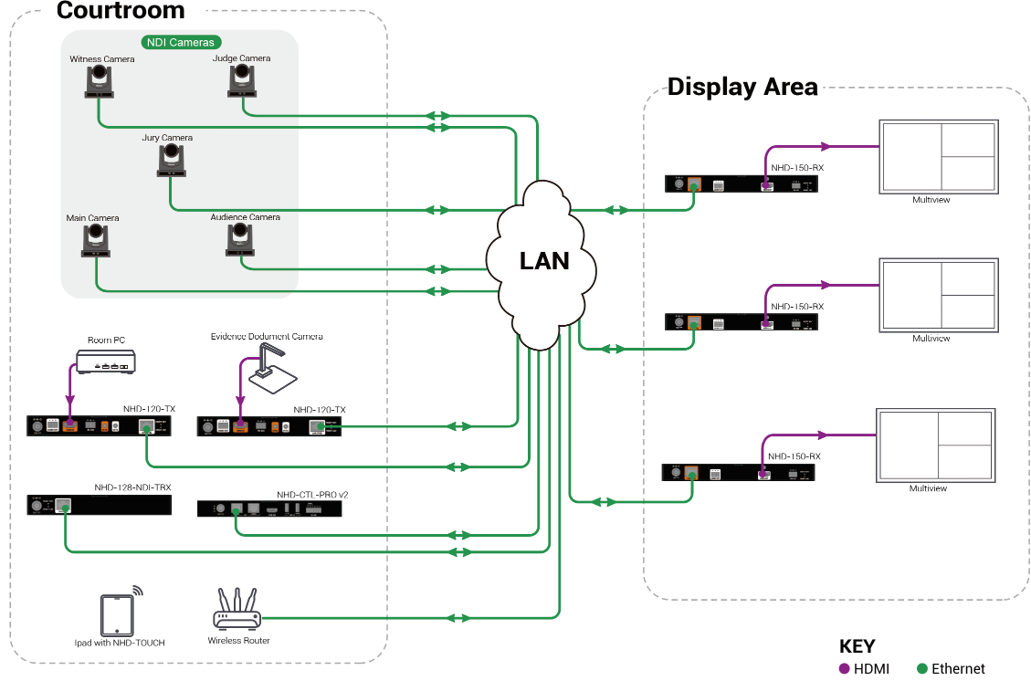
Typical Connection & Applications
Application Scenario 2: Digital Courtroom
This solution delivers a comprehensive AV system tailored for a digital courtroom environment.
It enables real-time display of multiple camera feeds and shared evidence documents in a multiview layout. The combined multiview output can also be converted to NDI for remote viewing or live streaming.
Key Benefits Include:
Multiview Function: Simultaneous display of camera feeds and shared content for a complete courtroom overview.
NDI Integration: Supports NDI camera convert into NetworkHD stream for AV over IP system.
Full-Court Coverage: Comprehensive video input from multiple courtroom cameras, including judge, jury, and evidence views.
Centralized Control: Intuitive system control via iPad with NHD-TOUCH and NHD-CTL-PRO for streamlined operation.
Flexible Signal Distribution: Seamlessly integrates both NetworkHD and NDI protocols over a standard LAN, ensuring reliable and scalable AV transmission.

Slide 12
Comparison with Other Competitors
 |  | WyreStorm NHD-128-NDI-TRX | UrayCoder UHE265-4-4K | Kiloview N40 | Magewell 641100000 | Magewell 640100000
 | Conversion Type | NetworkHD to NDI & NDI to NetworkHD | HDMI to NDI | HDMI to NDI & NDI to HDMI | NDI to HDMI | HDMI to NDI
Input | Video Input | 8x NDI stream, 1x NetworkHD stream | 4x HDMI input | 1x HDMI in, 1x NDI stream | 1x NDI stream | 1x HDMI in
 | Input Timing | Up to 4K@30Hz NetworkHD stream Up to 4K@30Hz NDI stream | Up to 4K@30Hz HDMI input | Up to4K@60Hz NDI stream Up to 4K@60Hz HDMI input | Up to 4K@60Hz NDI stream | Up to 4K@60Hz HDMI input
Output | Video Output | 8x NetworkHD stream, 1x NDI stream | 4x NDI stream | 1x HDMI out, 1x NDI stream | 1x HDMI out | 1x HDMI loop out 1x NDI stream
 | Output Timing | Up to 4K@30Hz NDI stream Up to 4K@30Hz NetworkHD stream | Up to 4K@30Hz NDI stream | Up to 4K@60Hz HMDI output Up to 4K@60Hz NDI stream | Up to 4K@60Hz HDMI output | Up to 4K@60Hz NDI stream
Others | NDI® Codec Capability | NDI® | HX(NDI 6) | N/A | NDI High Bandwidth | NDI® | HX/NDI High Bandwidth(NDI 5.x) | NDI® | HX/NDI High Bandwidth(NDI 5.x)
 | PoE | ✓ | × | ✓ | ✓ | ✓
 | LCD Screen | ✓ | × | × | × | ×

Slide 13
Quick Installation Guide
Effortlessly set up your NHD-128-NDI-TRX with simple steps, ensuring seamless configuration and an exceptional viewing experience.
Connect Interfaces: Connect the CAT cable to a PoE network switch (or using PSU to power on the device) for NHD-128-NDI-TRX.
Start the Device: Check the IP Address from the LCD screen, then log into the Web-UI for easy device configuration.
Create Conversion: Create your specified configuration via Web-UI. For detailed instructions, refer to the user manual.
Enjoy NDI and NetworkHD Conversion: NDI streams and NetworkHD streams can be freely converted and flexibly configured within the AV-over-IP system.
Powerful · Reliable · Simple

Slide 14
Important Notes for Installation
Check your network settings and confirm that the device is on the correct subnet.
Double-check configuration settings in the Web-UI to optimize functionality.
For complex settings, refer to the documentation or seek professional assistance if necessary.
Powerful · Reliable · Simple

Slide 15
Introduction of Web Configuration Interface
The Web UI of the NHD-128-NDI-TRX is designed for intuitive device management and control through any web browser. With the Web UI, you can easily configure and manage your conversion setup with the following features:
Key Web UI Configurations:
Conversion Configuration: Setting the IP address and conversion status between NDI and NetworkHD stream.
Conversion Management: Activate/Deactivate each conversion channel.
Powerful · Reliable · Simple

Slide 16

Final Thoughts
Q & A Session
Got questions? Don't hesitate to ask away.
Powerful · Reliable · Simple

